Slide 1
The Street Use Hourly Rate and Permit Fees are changing January 1st, 2022
Goals of the rate and fee updates:
Ensure full cost recovery to maintain service levels and reduce reliance on use fees
Align updates with policy goals to support businesses, homeowners, affordable housing, and improved livable communities

Slide 2
Background – Types of Street Use Fees
Permit Fees
Recovery: Administrative, some review time and overhead
Hourly Rate
Recovery: Review or inspection time and overhead
Use and Occupation Fees
Issuance, amendment and renewal fees
Review and inspection rates
Non-transportation uses of the right-of-way charged by the square footage
Discretionary: Used to encourage shorter and more efficient use of the public right-of-way

Slide 3
Summary of Proposed Changes
Issuance Fees
For construction and utility permits, update to full or partial full cost recovery
Hourly Rate
Update with 2019 – 2021 AWI
Use and Occupancy Fees
No change
For public activation and maintenance permits, update with 2019 – 2021 AWI
Keep free permits free (e.g., gardening, signs, block party etc.)

Slide 4
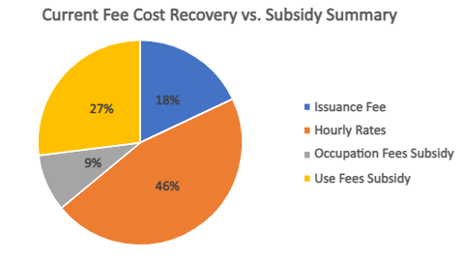
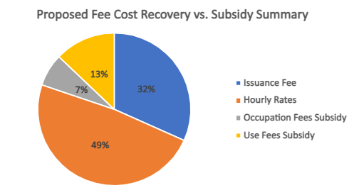
Current vs. Proposed Recovery Summary
We have not kept pace with cost increases over the past several years
This has led to subsidizing hourly rates and issuance fees with use and occupation fees
Use and occupation fees are intended to be used for transportation improvements that benefit those communities that have been impacted by construction

Slide 5
Hourly Rate Update
Current Hourly Rate | Proposed Hourly Rate​ | Difference
$278.00 ​ | $305.00 ​ | $27.00

Slide 6
Permit Fee Updates
Permit Type(s) | Current Fee | Proposed Fee | Difference
ROW Maintenance | $155.00 | $178.00 | $23.00
ROW Construction, Heavy Crane, & Minor Utility | $324.00 | $640.00 | $316.00
Public Activation & Vending | $181.00 | $275.00 | $94.00
Private Encroachment | $232.00 | $362.00 | $130.00
Renewal for Private Encroachments | $176.00 | $275.00 | $99.00
Street Vacations | $6,500.00 | $10,130.00 | $3,630.00
Long-term Encroachments (e.g., Skybridges, tunnels) | $232.00 | $362.00 | $130.00
Utility Major | $4,865.00 | $7,580.00 | $2,715.00
Street Improvement Lite | $4,865.00 | $2,900.00 | $(1,965.00)
Street Improvement | $4,865.00 | $7,580.00 | $2,715.00
Date Change, Extension, or Revision Amendment | $165.00 | $255.00 | $90.00
Block Party, Signs, Safe-streets, Gardening, Public Amenities | $0 | $0 | n/a

Slide 7

Questions?
Melody.Berry@seattle.gov
www.seattle.gov/transportation

